Slide 1
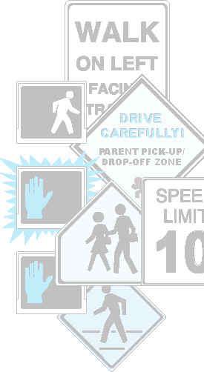
Practical Suggestions
Getting Children to School Safely: Parents are the Key
Parents can take the following measures to reduce school zone traffic hazards:
Don't park across the street from the school; if this is not possible, accompany your child (using a crosswalk) as he or she crosses the street.
Use the existing drop-off/pick-up system organized by the school.
If a drop-off/pick-up system does not exist or is poorly set up, work with the school officials to create or improve the system.
Reduce school zone congestion by carpooling with neighbors or friends.
Teach and encourage children to use designated crosswalks.
Follow instructions provided by school crossing guards.
And of course, always remember to use seat belts and appropriate child safety seats or booster seats when riding in a car.
In the United States, more children die as a result of motor vehicle incidents than from any disease. Almost a fourth of these deaths were young pedestrians.
This brochure offers a few simple recommendations to help parents get their children to school safely.
By following these simple recommendations, parents can play a key role in keeping their children safe.
.
DRIVE CAREFULLY!
PARENT PICK-UP/ DROP-OFF ZONE

Slide 2
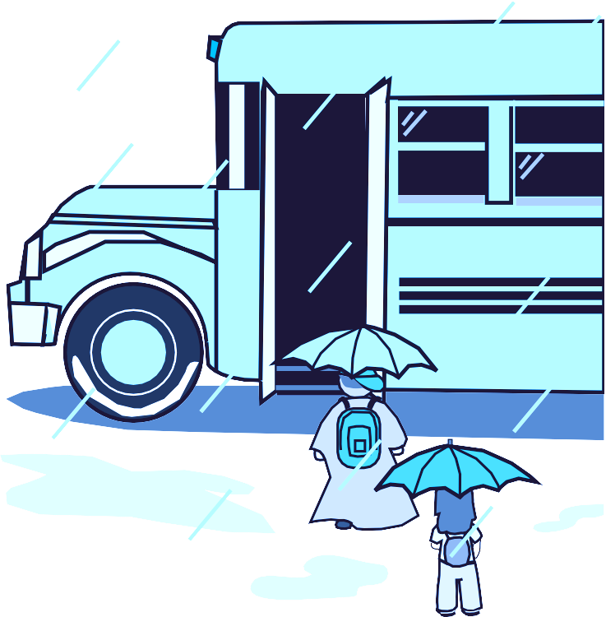
Troubling Statistics
Children Walking to School or the Bus Stop - Are They Safe?
Walking is good exercise for children, but it is up to parents to decide if walking to school or to the bus stop is safe.
Have children walk in a group. With more eyes and ears, they can cross streets together and negotiate dangerous situations more safely. Having an adult walk with the group can make the trip even safer.
Talk with children about traffic safety and teach them when and where it is safest to cross. Always use crosswalks yourself in order to model safe behavior.
Don't forget to emphasize the importance of visually scanning dangerous areas such as driveways and parking lots. Remind children to take their time and look both ways when crossing streets, even when there is a well- marked crosswalk.
In the year 2000, according to the National Highway Traffic Safety Administration:
29% of pedestrians injured were under 15 years old.
43% of school-aged pedestrian fatalities occurred between 4 p.m. and 8 p.m.
When deciding if it is safe for a child to walk to school, parents should consider the following factors:
Almost 1 out of 4 children (23%) between ages of 5 and 9 killed in traffic crashes were pedestrians.
The child's age-Children under the age of 9 or 10 usually do not have the skills to walk alone in areas with traffic. Parents should consider the readiness of each individual child, regardless of age, for the traffic situation.
Traffic-The volume and speed of traffic may not allow a safe route to school.
Crime-High crime areas create an unsafe environment and potentially dangerous situations.
Street Signs and Traffic Signals-Adequately posted signs and traffic signals can help protect drivers and children from traffic crashes.
Crossing Guards-At intersections where many children cross, crossing guards can help to get them to the other side safely.
Distance to the school-With increased distance, the risk of encountering a traffic safety hazard increases
On the Way to School
Ensuring the safety of their children is a top priority
for all parents. Regardless of how a child commutes to school, he or she may face many traffic safety hazards. Whether children walk, take the bus, or
ride in a car, parents can play a key role in getting them to school safely.
Congestion and Other School Zone Traffic Hazards
School Zone traffic congestion is a significant safety hazard for school children throughout the country.
Every day, caring parents unknowingly create traffic hazards as they drop off or pick up their children. By making simple changes in our daily routine, the danger to all children can be reduced.
SCHOOL
Determining if a child is safe to walk to school is an important decision. Even after deciding it is safe, there are still several ways that parents can ensure a safer commute for their children. What parents can do to make their children's walks safer:
As congestion increases in a school zone, it becomes more difficult for parents and children to see one another. As a result, collisions are more likely to occur.
Walk with children many times to familiarize them with the route. This creates an opportunity to point out potential traffic hazards and situations to avoid.
In addition, parents may park across the street to drop off or pick up their children. This exposes children to a greater risk of being hit because they must cross the street to reach their destination.

